Slide 1
Malignant Comments Classifier
Comments Analysis

Slide 2
TASK
Comment Text
Malignant
Loathe
Rude
Threat
Abuse
Highly Malignant

Slide 3
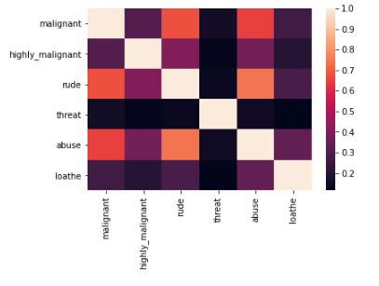
EDA & VISUALIZATIONS
Correlation between multiple target labels

Slide 4
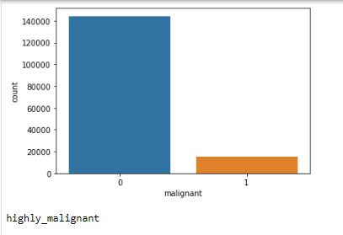
EDA & VISUALIZATIONS
Count Plot for Malignant Label

Slide 5
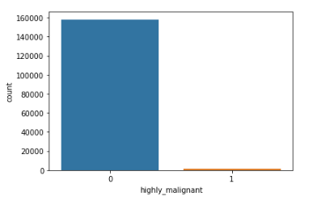
EDA & VISUALIZATIONS
Count Plot for Highly Malignant Label

Slide 6
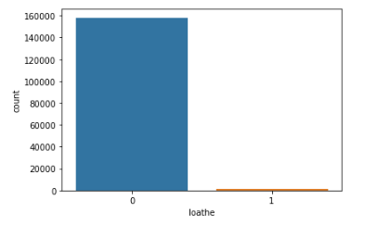
EDA & VISUALIZATIONS
Count Plot for Loathe Label

Slide 7
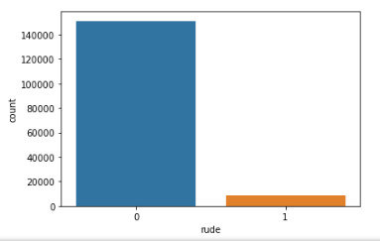
EDA & VISUALIZATIONS
Count Plot for Rude Label

Slide 8
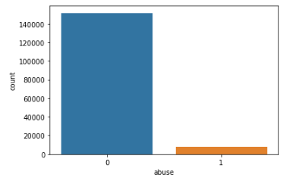
EDA & VISUALIZATIONS
Count Plot for Abuse Label

Slide 9
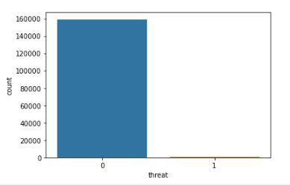
EDA & VISUALIZATIONS
Count Plot for Threat Label

Slide 10
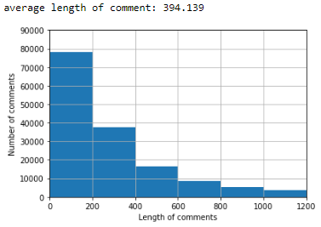
EDA & VISUALIZATIONS
Length of Comments

Slide 11
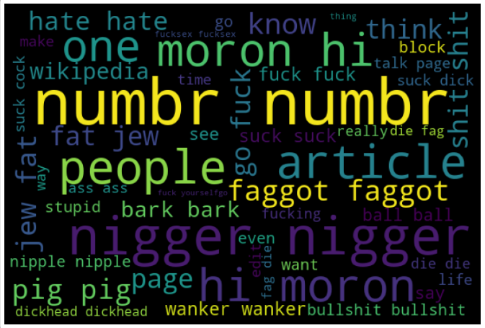
EDA & VISUALIZATIONS
Comments Word Cloud

Slide 12
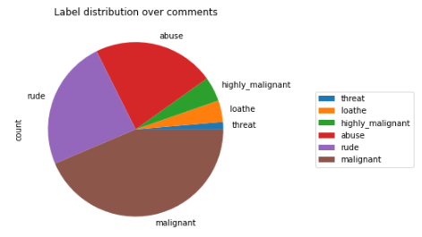
EDA & VISUALIZATIONS
Type of Comments

Slide 13
Scope of future work
For the future scope, below can be deliberated upon:
Sensitize words classified as malignant.
Auto-sending to alerts to concerned authorities if comments classified as highly malignant.

